Slide 1

Our trip to Cuba
By the «Cuba Squad»
EEB1 – S7 Music Class (MU4ENA) – 2018/2019

Slide 2
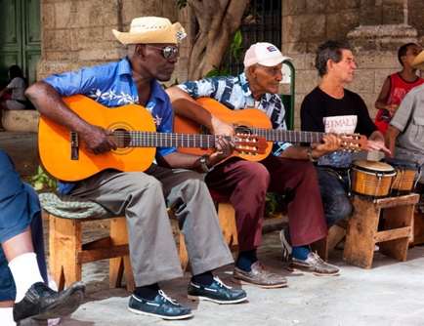
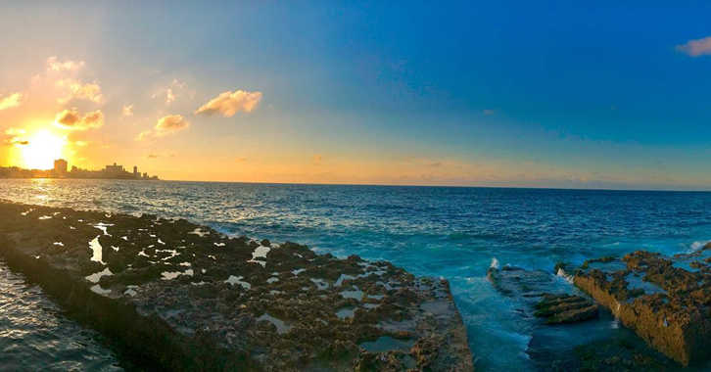
Our trip to Cuba
Welcome to our little presentation of our trip to Cuba!
First and foremost, we would want to thank you so much for having supported our trip! It was an unforgettable experience, and we wouldn’t have been able to go if it hadn’t been for the school's support!
We want to share with you our performance at the school’s Christmas concert on 2 December where we played the music we learnt in Cuba:
  https://youtu.be/MAvSrubpTLY
  https://youtu.be/hXm8AqqWyW4
We went to Cuba at the end of October for a week. We made two main stops: Havana, where we stayed for five days, and Varadero, where we stayed for two days.

Slide 3
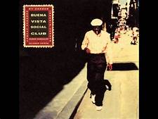
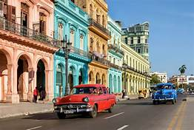
Havana
During our stay in Havana, we had the amazing opportunity to have each day a five hour precussion lesson, where we learned to play the traditional Cuban intruments which were taught by local percussion players. We learnt to play classic Cuban songs, such as «Chan Chan» by Buena Vista Social Club and «Guantanamera». After our lessons, we had city tours of the Old and New Havana, where we were really able to properly dive into the Cuban culture. There was music in every corner of the city, people dancing and laughing, it was an amazing atmosphere in the city, a truly beautiful city. On the third day, we went to the house of Compay Segundo, a member of the «Buena Vista Social Club», where we were able to see his house, his instruments, and the prizes he won for his music.
We also had a salsa class, where we learned the signature dance of the Cuban people, and we had lots of fun. On the last evening, we attended a Buena Vista Social Club concert, where we were able to experience the Cuban music live, whilst dancers were doing the salsa in the audience. It was a night to remember!
Thanks to our guide, Alian, we got a full experince of the Cuban lifestyle, music and history, and were able to understand how other Western countries had affected the Cuban culture, especially the music.

Slide 4
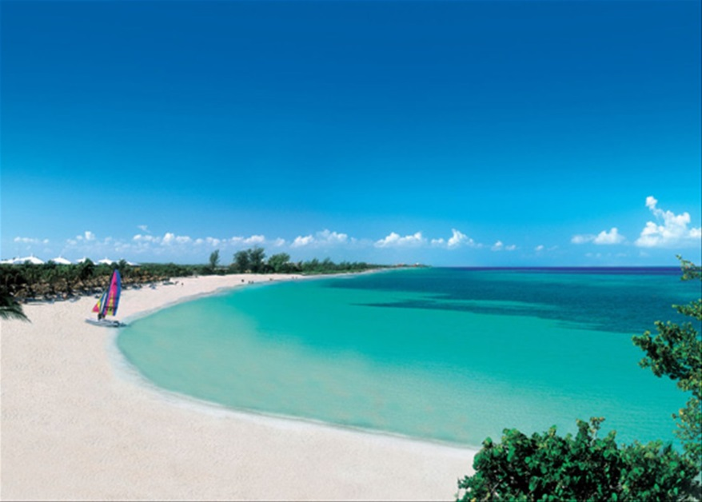
Varadero
After five days, we sadly had to leave Havana behind. Our next stop was Varadero, a beautiful site next to the carribean sea, where we stayed for our last two days. In Varadero we just relaxed and enjoyed the carribean temperature and beaches after a hard working week in Havana. We hung out at the beach for most of the time, sun bathed, listened to cuban music, swam in the beautiful, warm sea and enjoyed our last days in Cuba to the fullest!

Slide 5
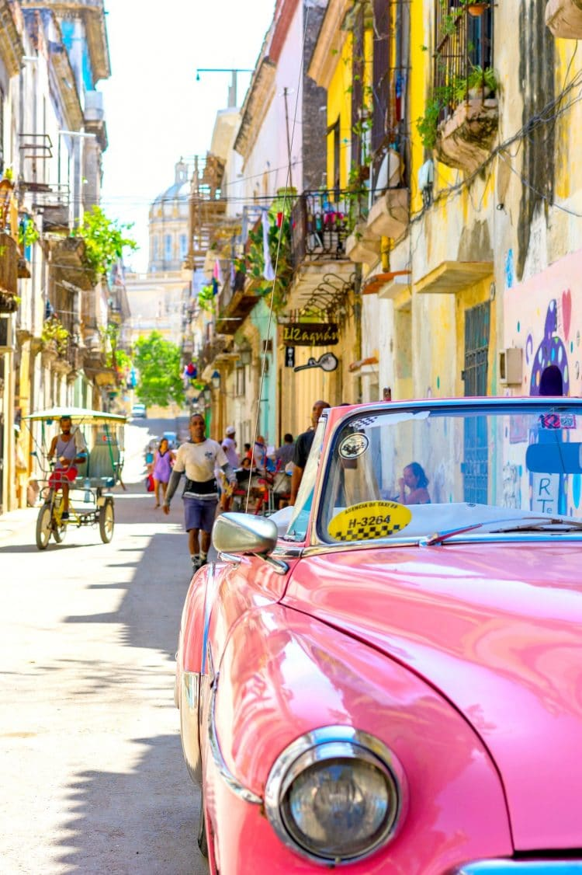
Thank you!
We want to thank you for helping us getting a first hand experience of Cuba’s amazing culture, history and, of course, music!
We couldn’t have gone on our trip if it weren’t for you, and we are so grateful for your generosity! We will always remember our amazing experience, and how it has broadened our musical horizons, and being able to see a culture so different from ours!
Lots of love from the Cuba Squad
- Astrid, Mia, Kat, Juan, Nicky, Benny -
and our music teacher Andrea Kovacs

